Slide 1

Business Analysis project
Utkarsh Som 2020A7PS0903U
Sanskriti
rushi​

Slide 2

UCI
Bike sharing data
Introduction
Understanding the dataset
Data preprocessing
Exploratory data analysis
Descriptive analysis
Predictive analysis
Summary

Slide 3

Timeline
EDA
ANOvA
Hypothesis
MLR
REsults

Slide 4

Introduction
Our analysis delves into the rich data provided by the UCI Bike Sharing Dataset This dataset offers valuable insights into user behaviors, seasonal trends, and operational patterns within the bike-sharing industry. Through meticulous examination and analysis, our group has unearthed key findings that illuminate opportunities and challenges for stakeholders in this thriving sector.

Slide 5

dataset
The UCI Bike Sharing Dataset contains two table:
- Table ‘hour’ comprises of 17,379 records along 18 dimensions
- Table ‘day’ comprises 731 records along 17 dimensions
The dataset includes a wide array of features such as temporal variables like date, month, hour, and day of the week, allowing for the exploration of seasonal trends and daily usage patterns. Additionally, categorical features like season and weather conditions shed light on how external factors impact bike rental demands.
Meteorological variables like temperature, feeling temperature, humidity, and wind speed provide insights into how weather conditions affect bike rental preferences.
Moreover, the dataset distinguishes between holidays, working days, and weekends, enabling analysis on how these different types of days influence bike sharing usage.

Slide 6

Understanding the dataset
We began by understanding the structure and content of the dataset. This involved examining the variables, their descriptions, and their types to gain insight into the available information.
The dataset consists of daily records of bike-sharing usage across a two-year period (2011 and 2012). Each record provides information on the number of bikes rented on a particular day, alongside several features that could potentially influence bike rental patterns.
With this report we aim to find trends in the rental business and maximize sales.
Hence choosing our Target Variable: Count

Slide 7

Understanding the dataset
Temporal features
uSAGE features
USAGE features
dteday: The date of the record.
season: The season during which the record was taken (1: Winter, 2: Spring, 3: Summer, 4: Fall).
yr: The year of the record (0: 2011, 1: 2012).
mnth: The month of the record (1 to 12).
weekday: The day of the week (0: Sunday, 1: Monday, ..., 6: Saturday).
holiday: Whether the day is a public holiday (1) or not (0).
workingday: Whether the day is a working day (1) or not (0).
casual: Count of casual users (unregistered).
registered: Count of registered users.
count: Total count of users [‘casual’] + [‘registered’].
WEATHER FEATURES
weathersit: The weather situation (1: Clear, 2: Few clouds, 3: Partly cloudy)
temp: Normalized temperature in Celsius.
atemp: Normalized feeling temperature in Celsius.
hum: Normalized humidity.
windspeed: Normalized wind speed

Slide 8
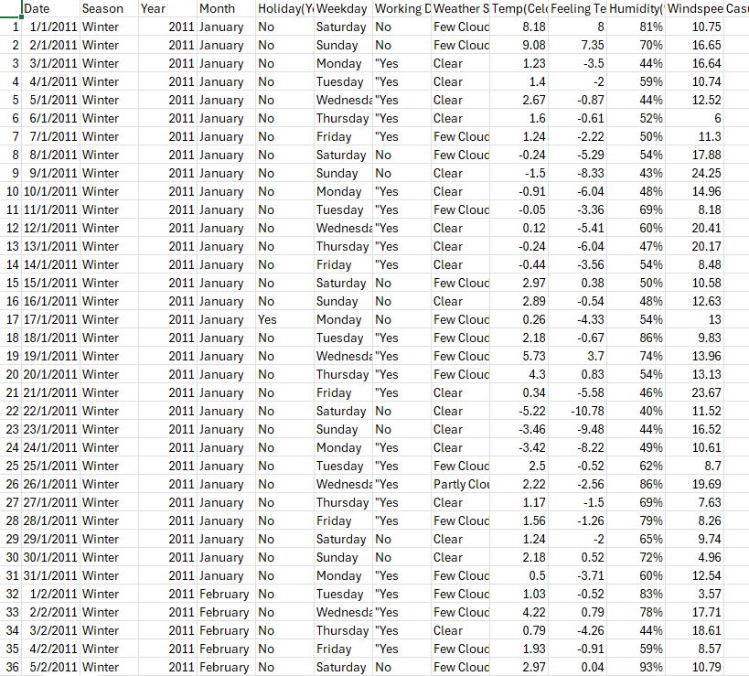
Data Preprocessing
We performed the following preprocessing steps to ensure the dataset was ready for analysis:
Tool used: MS Excel
Date Conversion: We converted the dteday column to a datetime object to facilitate time series analysis.
Feature Mapping: Categorical features like season, yr, and weathersit were mapped to their corresponding names for better readability.
Normalization: We understood that some weather-related features (temp, atemp, hum, and windspeed) were normalized. We noted this to interpret the values correctly during analysis.

Slide 9
Exploratory Data Analysis
We conducted an EDA to gain initial insights into the data: Tool used: python
Descriptive Statistics: We calculated summary statistics (mean, median, standard deviation) for continuous variables to understand their distribution and central tendency.
Data Visualization: We used various plots to visualize the data:
  Time Series Plots: To observe trends and seasonal patterns in bike rentals over time.
  Scatter Plots: To explore relationships between weather conditions (e.g., temperature, humidity) and bike rentals.
  Histograms: To examine the distribution of bike rentals and other features.
  Box Plots: To identify outliers and understand the spread of continuous variables.

Slide 10
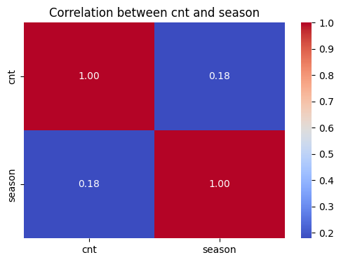
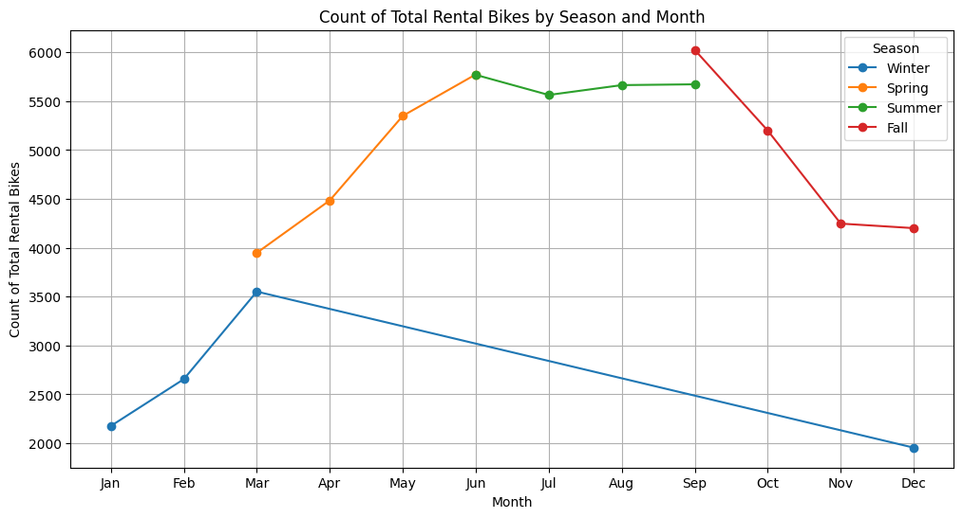
EDA
Seasonality:
  Bike rentals showed clear seasonal patterns, with higher rentals during certain months and seasons.
  while the correlation between bike rentals and months is not strong, there are notable seasonal patterns. Fall, especially September, experiences the peak of bike rentals, whereas summer maintains a stable level of rental activity.
  Understanding these patterns can help bike rental services optimize their operations and marketing strategies to better meet customer demand throughout the year.

Slide 11
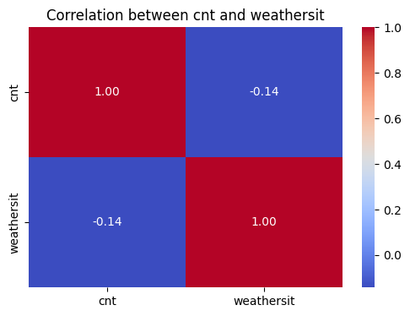
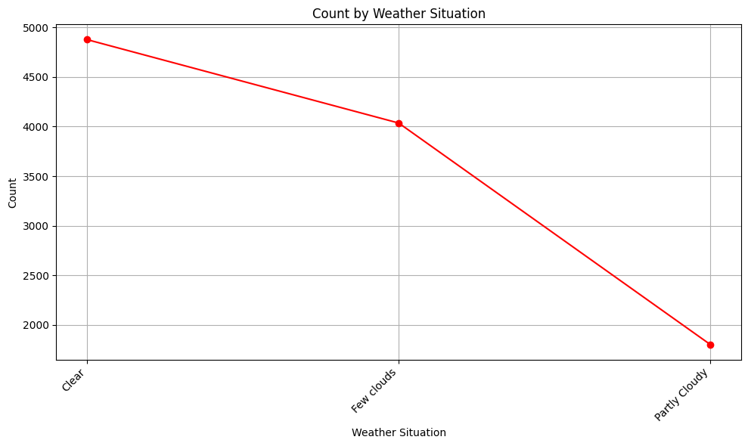
EDA
Weather impact (weather Situation):
  As weather situation changes, so does the number of bike rentals, highlighting how weather changes influence biking behavior.
  While the correlation between weather situation and rental counts is negative, it is relatively weak. With highest number of rentals with a clear sky.

Slide 12

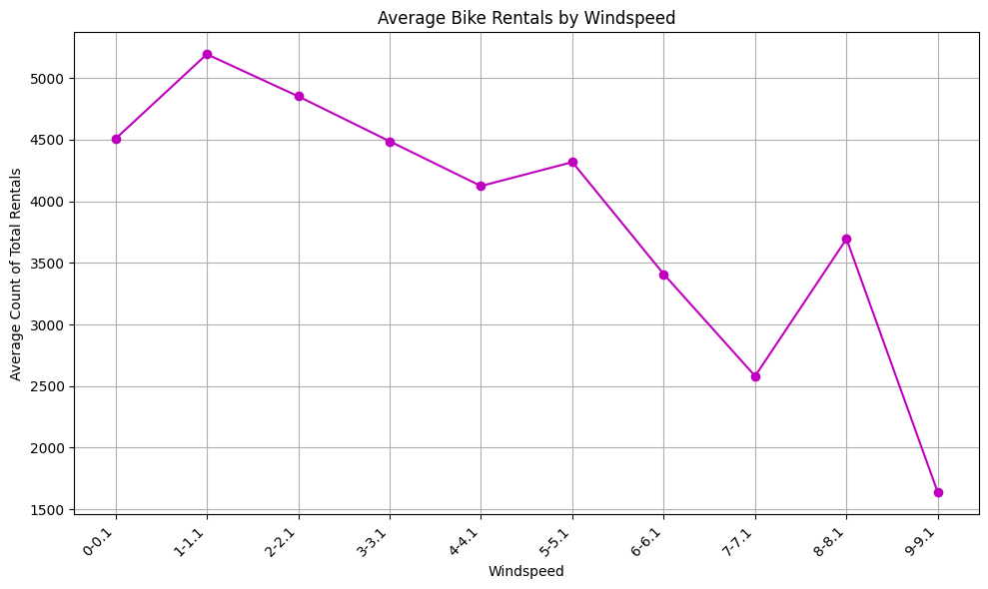
EDA
Weather impact (windspeed):
  The correlation matrix between ‘windspeed’ and ‘count’ shows us a positive correlation of 0.09.
  It can been seen in the charts, the trend between the both is not certain.
  Hence it can be concluded that ‘windspeed’ has minimal to no impact on the bike rental business.

Slide 13
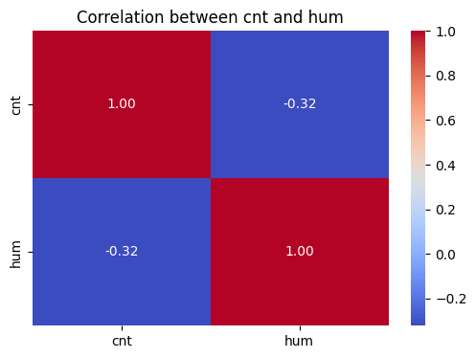
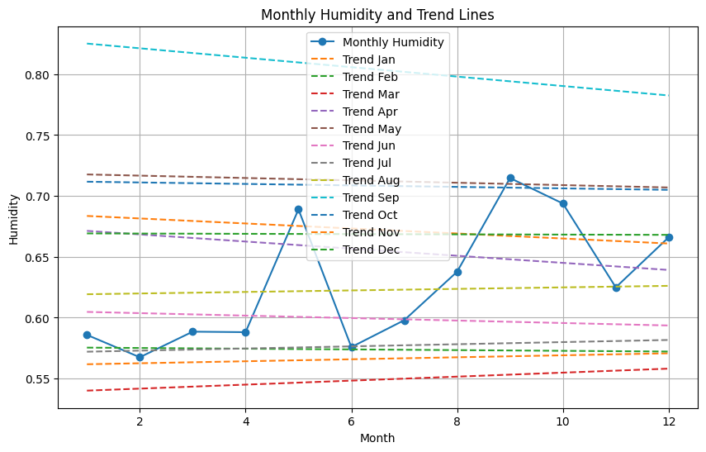
EDA
Weather impact (Humidity):
  With negative correlation of -0.32 and the trend line we can see that humidity is a strong factor affecting the bike rental business.
  As humidity fades away in fall and spring, the line plot shows a sudden increase in the number of bikes rented.

Slide 14
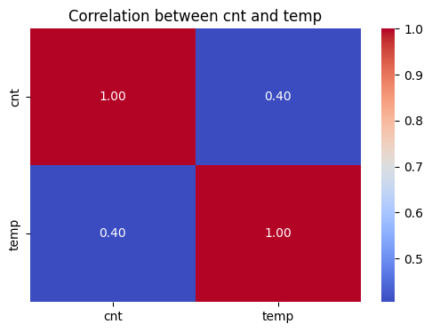
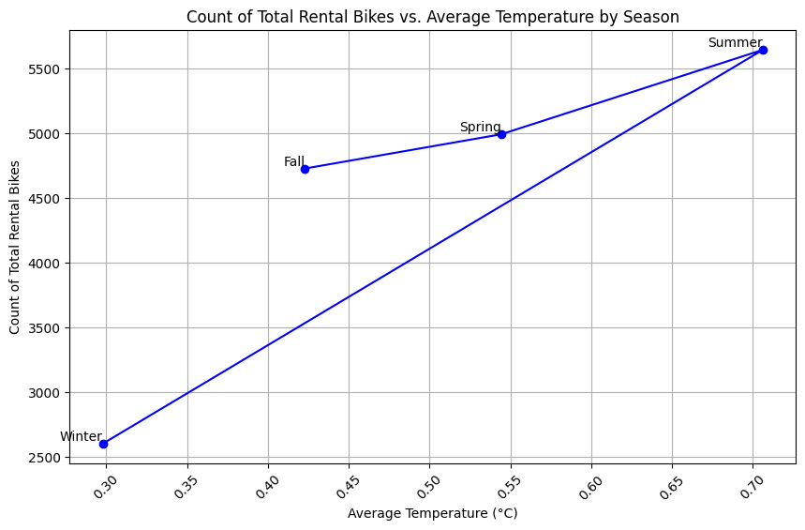
EDA
Weather impact (Temp):
  As temperature increases into summer, so does the number of bike rentals, with relatively high correlation of 0.4.
  Amongst all the weather factors, temperature proves to have the strongest affect on our target variable, count.

Slide 15

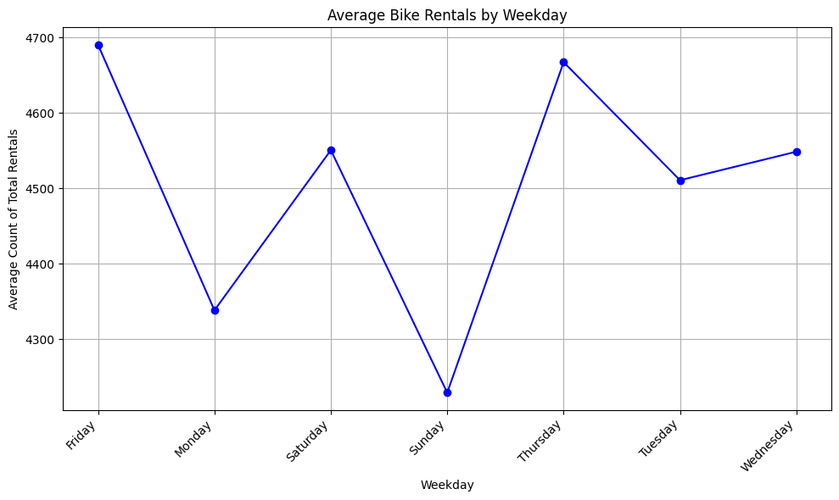
EDA
Day of the week:
  Most of the working days show high number of bike rental. With surprisingly least number of rentals on Sunday
  With correlation relatively very low as 0.03, it can be said day of the week does not have much affect on the bike rental business.
  Now we check the correlation between rental number and the Holiday class.

Slide 16
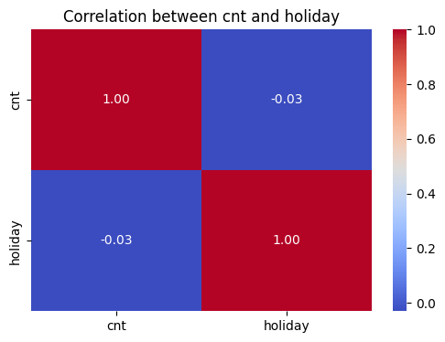
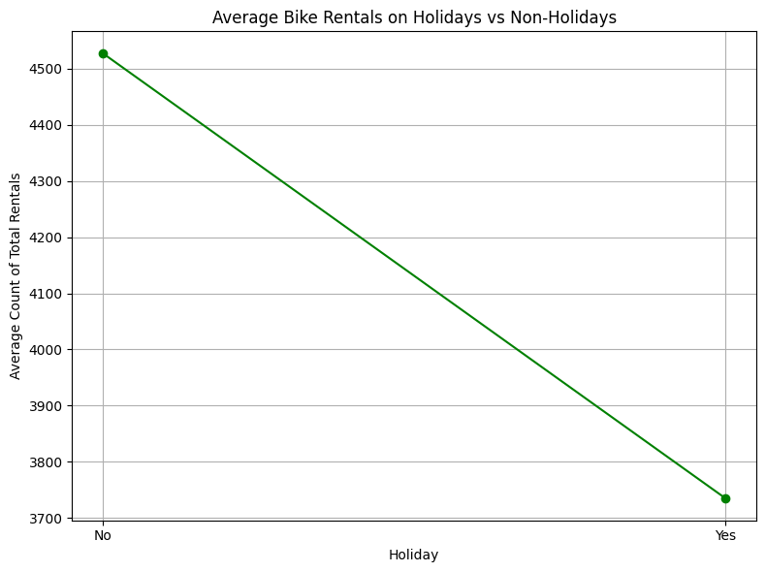
EDA
Holidays:
  With average number of bike rental higher on Non-Holidays, with negative correlation as low as -0.03, not much can be inferred.
  Contrary, seeing the trend between ‘day of the week’ and ‘holiday’ in the report, it can be naively inferred that people tend to use the bike rental service to commute on non-holidays/working days.

Slide 17
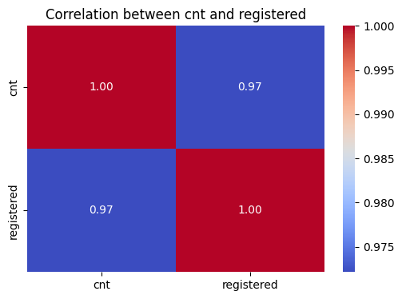
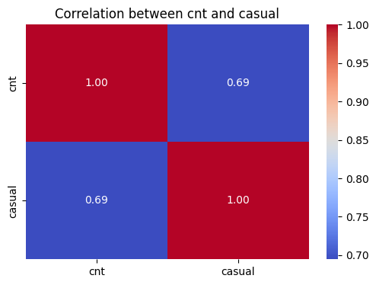
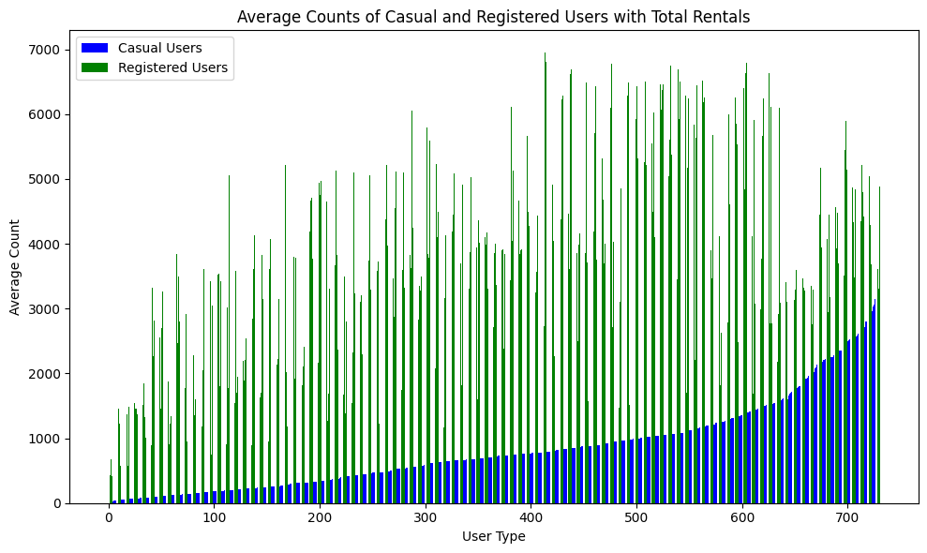
EDA
User type:
  User type is divided into ‘Casual’ and ‘Registered’ showing correlation 0.69 and 0.97 respectively.
  It can also be seen in the plot, the number of registered users significantly surpasses the number of casual users.
  Hence with high correlation of 0.97, it can be concluded that the bike rental business is highly dependent on the number of registered users.
  Hence as the business manager, we should focus on getting more people registered on our platform.

Slide 18
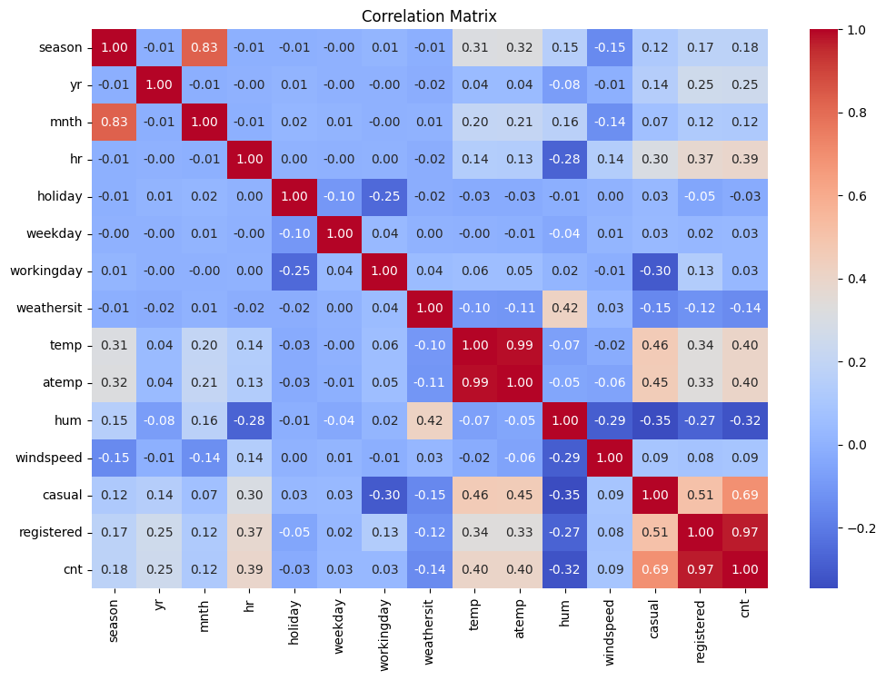
EDA
  As seen in the correlation matrix,
    Month and Season are strongly correlated with correlation = 0.83
    It can also be inferred temperature and absolute temperature show high correlation.
    As discussed previously user type also has a high correlation with the number of bikes rented.
    No significant negative correlation seen in the matrix.

Slide 19

Descriptive analysis

Slide 20
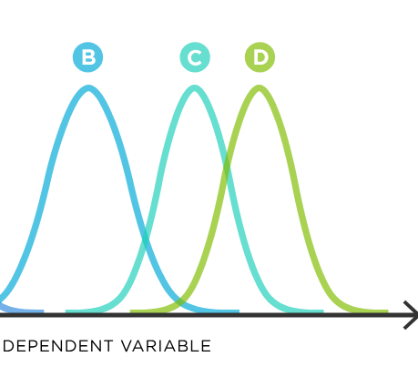
Analysis of variance
Tool used: python
F-test, Confidence level: 0.95
Target variable: Count
By using ANOVA, we can find out if there are any significant differences in rental counts between these groups. It helps us identify which factors have a real impact on rental numbers, rather than just random variation.
Another benefit of ANOVA is that it helps us control for errors that could happen by chance. Instead of testing each group separately, ANOVA evaluates them all together, making our analysis more efficient and reliable.
ANOVA helped us understand what factors influence bike rental numbers and how they interact with each other.

Slide 21
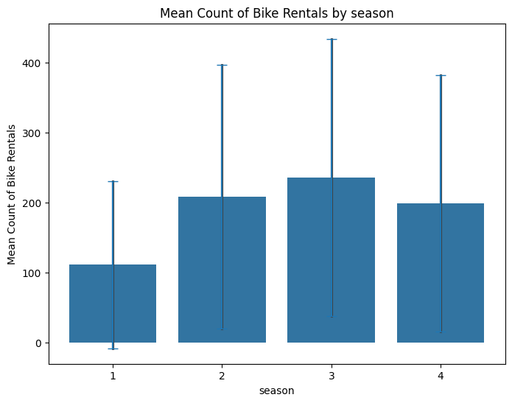
Anova
Anova for season:
  With an F-statistic of approximately 409.18, this indicates a large amount of variability exists between the mean rental counts of different seasons compared to the variability within each season. This suggests that the seasons have a significant effect on bike rental counts.
  The p-value associated with the F-statistic is approximately 7.40e-257, an extremely small value. This tiny p-value indicates strong evidence against the null hypothesis, which posits that there are no significant differences in rental counts across seasons. Therefore, we reject the null hypothesis in favor of the alternative, concluding that there are indeed significant differences in rental counts across seasons.
  The ANOVA results confirm that seasonality significantly impacts bike rental counts, highlighting the importance of considering seasonal variations in planning and decision-making for bike rental businesses.
  ANOVA for season: F-statistic: 409.1810372630525, p-value: 7.40107139971279e-257

Slide 22
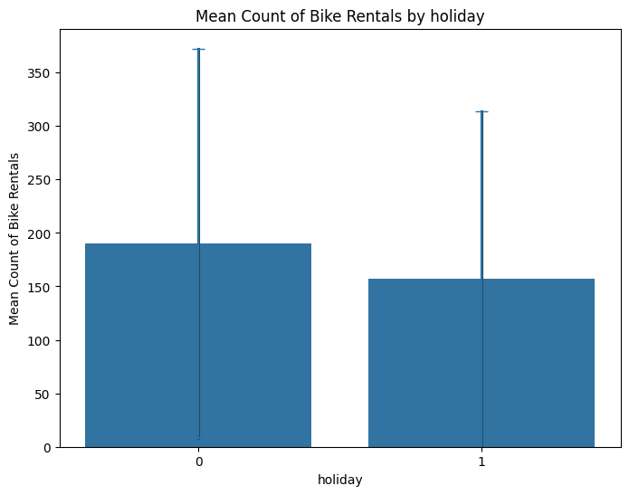
Anova
anova for holiday:
  The F-statistic measures the ratio of variation between group means to the variation within the groups. In this context, it suggests whether there are significant differences in bike rental counts between holidays and non-holidays. The value of 16.64 indicates that there is a moderate amount of variability between the mean rental counts of these two groups compared to the variability within each group.
  The p-value associated with the F-statistic is approximately 4.55e-05, which is significantly smaller than the conventional significance level of 0.05. This small p-value suggests strong evidence against the null hypothesis, indicating that there are significant differences in rental counts between holidays and non-holidays.
  The ANOVA results highlight that holidays significantly influence bike rental counts, emphasizing the need for businesses to account for these variations in their operational and marketing plans.
  ANOVA for holiday: F-statistic: 16.636980484977737, p-value: 4.546168948723332e-05

Slide 23
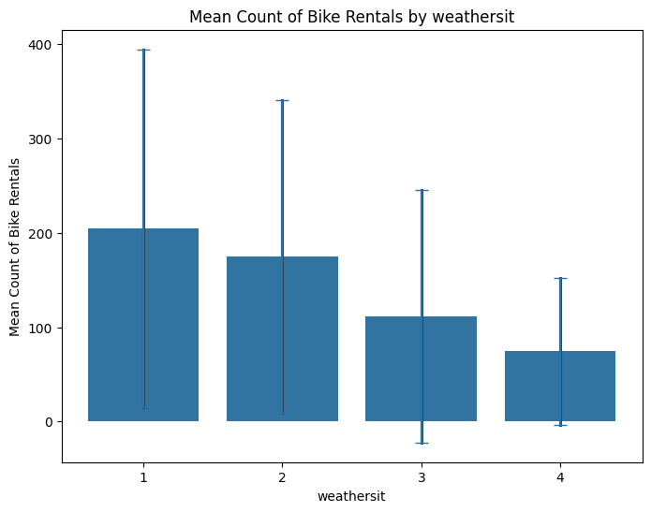
Anova
anova for weather situation:
  F-statistic: With an F-statistic of 127.17, this suggests that there is a substantial amount of variability between the mean rental counts across different weather situations compared to the variability within each weather situation. This indicates that the "weathersit" variable likely has a significant effect on bike rental counts.
  The associated p-value of approximately 1.73e-81 is extremely small, much smaller than the conventional significance level of 0.05. This tiny p-value provides strong evidence against the null hypothesis, indicating that there are indeed significant differences in rental counts across different weather situations.
  The ANOVA results highlight the significant influence of weather situations on bike rental counts, underscoring the importance of considering weather-related factors in business planning and strategy development for bike rental services.
  ANOVA for weathersit: F-statistic: 127.17386949967266, p-value: 1.7347820521803117e-81

Slide 24
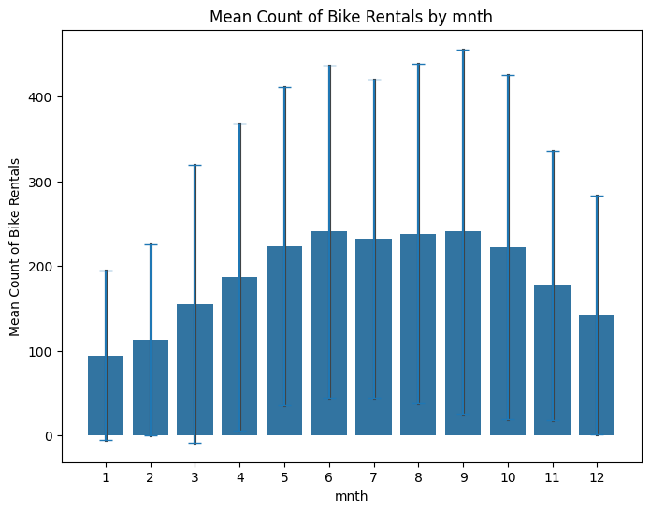
Anova
anova for month:
  The F-statistic measures the ratio of variation between group means to the variation within the groups. In this case, it indicates whether there are significant differences in bike rental counts across different months. With a high F-statistic of 128.10, it suggests that there is a considerable amount of variability in the mean rental counts among the different months compared to the variability within each month
  The p-value associated with the F-statistic is extremely small, approximately 5.51e-284, indicating strong evidence against the null hypothesis. The null hypothesis posits that there are no significant differences in rental counts across months. Since the p-value is much smaller than the conventional significance level of 0.05, we reject the null hypothesis and conclude that there are indeed significant differences in rental counts across months.
  The ANOVA results highlight the significant impact of the month variable on bike rental counts, emphasizing the need for businesses to consider temporal patterns and seasonality in their operational and strategic decision-making processes
  ANOVA for mnth: F-statistic: 128.1021897089323, p-value: 5.50568493648436e-284

Slide 25
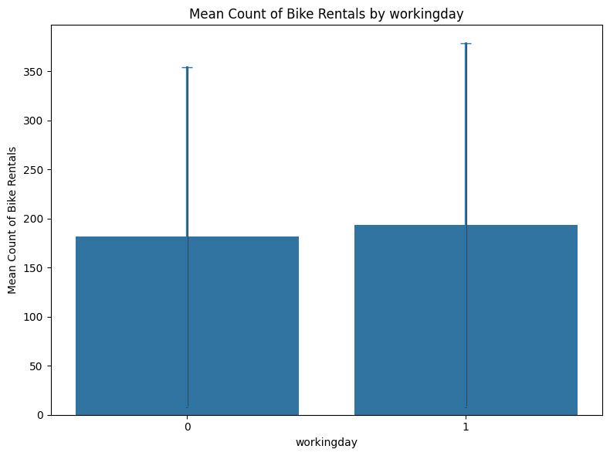
Anova
anova for working day:
  The F-statistic measures the ratio of variation between group means to the variation within the groups. In this context, it indicates whether there are significant differences in bike rental counts between working days and non-working days. With a moderate F-statistic of 15.95, it suggests that there is a moderate amount of variability in the mean rental counts between these two groups compared to the variability within each group.
  The associated p-value of approximately 6.52e-05 is significantly smaller than the conventional significance level of 0.05. This small p-value provides strong evidence against the null hypothesis, which posits that there are no significant differences in rental counts between working days and non-working days. Therefore, we reject the null hypothesis and conclude that there are indeed significant differences in rental counts between these two categories.
  The ANOVA results highlight the significant influence of the "workingday" variable on bike rental counts, underscoring the importance of considering temporal patterns and weekday vs. weekend dynamics in business planning and strategy development for bike rental services.
  ANOVA for workingday: F-statistic: 15.95182279420313, p-value: 6.524264547051995e-05

Slide 26
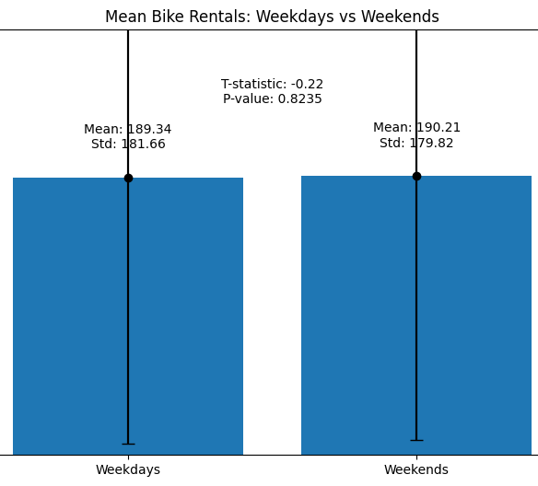
Hypothesis testing
Tool used: python
T-test, Confidence level: 0.95
Hypothesis testing: whether there is a significant difference in the mean bike rental counts between weekdays and weekends.
The null hypothesis (H0) is that there is no difference in the mean counts.
Alternative hypothesis (Ha) is that there is a difference.
The t-test helps evaluate whether the observed difference in means is statistically significant, based on the calculated t-statistic and p-value.
The t-test results indicate that there is no statistically significant difference in bike rental counts between weekdays and weekends, highlighting the importance of considering multiple factors when analyzing rental patterns and making business decisions.
Tool used: python
T-test, Confidence level: 0.95
T-statistic: -0.22306957521789678, p-value: 0.8234839791816918

Slide 27
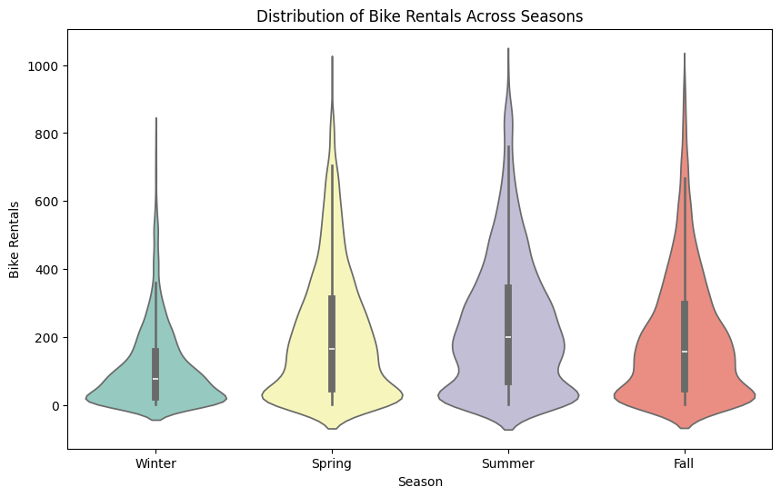
Hypothesis testing
Tool used: python
T-test, Confidence level: 0.95
Pairwise T-test between Seasons and Counts
For each pair of seasons (excluding comparisons with themselves), a t-test is performed to assess whether there is a significant difference in bike rental counts between the two seasons.
The t-test calculates a t-statistic and a p-value for each pair of seasons.
The t-statistic measures the difference between the means of the rental counts relative to the variation within the groups, while the p-value indicates the probability of observing such extreme results if the null hypothesis (no difference in means) is true.
There are significant differences in bike rental counts between Winter (Season 1) and the other seasons (Spring, Summer, and Fall).Alternative hypothesis (Ha) is that there is a difference.
Similarly, there are significant differences in rental counts between Spring (Season 2) and the other seasons (Summer and Fall)..
Significant differences also exist between Summer (Season 3) and Fall (Season 4).
However, there is no significant difference in rental counts between Spring (Season 2) and Fall (Season 4), except for a small difference with a p-value of 0.0178, which is still statistically significant but less pronounced compared to other pairs.
T-test between Season 1 and Season 2: T-statistic=-28.56, p-value=0.0000 T-test between Season 1 and Season 3: T-statistic=-35.50, p-value=0.0000 T-test between Season 1 and Season 4: T-statistic=-26.16, p-value=0.0000 T-test between Season 2 and Season 1: T-statistic=28.56, p-value=0.0000 T-test between Season 2 and Season 3: T-statistic=-6.76, p-value=0.0000 T-test between Season 2 and Season 4: T-statistic=2.37, p-value=0.0178 T-test between Season 3 and Season 1: T-statistic=35.50, p-value=0.0000 T-test between Season 3 and Season 2: T-statistic=6.76, p-value=0.0000 T-test between Season 3 and Season 4: T-statistic=9.09, p-value=0.0000 T-test between Season 4 and Season 1: T-statistic=26.16, p-value=0.0000 T-test between Season 4 and Season 2: T-statistic=-2.37, p-value=0.0178 T-test between Season 4 and Season 3: T-statistic=-9.09, p-value=0.0000

Slide 28
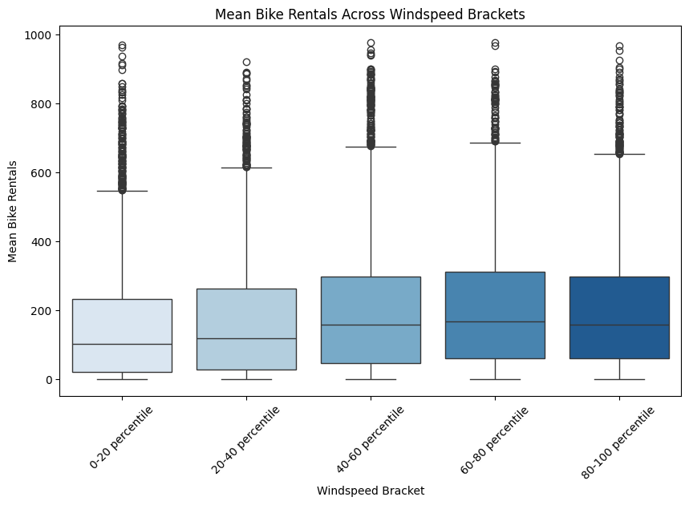
Hypothesis testing
Tool used: python
T-test, Confidence level: 0.95
Pairwise T-test between Windspeed and Counts
Pairwise t-tests are conducted between windspeed brackets to determine if there are significant differences in bike rental counts between different windspeed ranges. The t-test calculates a t-statistic and a p-value for each pair of seasons.
These results provide insights into the differences in bike rental counts across various windspeed ranges. Significant differences are observed between certain percentile brackets, indicating that windspeed has an impact on bike rental activity. However, the effect may vary across different windspeed ranges
The comparison between the 40-60 percentile and 80-100 percentile brackets has a larger p-value of 0.3092, indicating less significance compared to the other comparisons.
Therefore, the comparisons with p-values of 0.0000 are more significant, suggesting strong evidence of differences in bike rental counts between the respective windspeed brackets
T-test between Windspeed Brackets 0-20 percentile and 20-40 percentile: T-statistic=-3.68, p-value=0.0002
T-test between Windspeed Brackets 0-20 percentile and 40-60 percentile: T-statistic=-11.77, p-value=0.0000
T-test between Windspeed Brackets 0-20 percentile and 60-80 percentile: T-statistic=-12.35, p-value=0.0000
T-test between Windspeed Brackets 0-20 percentile and 80-100 percentile: T-statistic=-11.88, p-value=0.0000
T-test between Windspeed Brackets 20-40 percentile and 0-20 percentile: T-statistic=3.68, p-value=0.0002
T-test between Windspeed Brackets 20-40 percentile and 40-60 percentile: T-statistic=-7.70, p-value=0.0000
T-test between Windspeed Brackets 20-40 percentile and 60-80 percentile: T-statistic=-8.89, p-value=0.0000
T-test between Windspeed Brackets 20-40 percentile and 80-100 percentile: T-statistic=-8.09, p-value=0.0000
T-test between Windspeed Brackets 40-60 percentile and 0-20 percentile: T-statistic=11.77, p-value=0.0000
T-test between Windspeed Brackets 40-60 percentile and 20-40 percentile: T-statistic=7.70, p-value=0.0000
T-test between Windspeed Brackets 40-60 percentile and 60-80 percentile: T-statistic=-2.52, p-value=0.0119
T-test between Windspeed Brackets 40-60 percentile and 80-100 percentile: T-statistic=-1.02, p-value=0.3092
T-test between Windspeed Brackets 60-80 percentile and 0-20 percentile: T-statistic=12.35, p-value=0.0000
T-test between Windspeed Brackets 60-80 percentile and 20-40 percentile: T-statistic=8.89, p-value=0.0000
T-test between Windspeed Brackets 60-80 percentile and 40-60 percentile: T-statistic=2.52, p-value=0.0119
T-test between Windspeed Brackets 60-80 percentile and 80-100 percentile: T-statistic=1.50, p-value=0.1334
T-test between Windspeed Brackets 80-100 percentile and 0-20 percentile: T-statistic=11.88, p-value=0.0000
T-test between Windspeed Brackets 80-100 percentile and 20-40 percentile: T-statistic=8.09, p-value=0.0000
T-test between Windspeed Brackets 80-100 percentile and 40-60 percentile: T-statistic=1.02, p-value=0.3092
T-test between Windspeed Brackets 80-100 percentile and 60-80 percentile: T-statistic=-1.50, p-value=0.1334

Slide 29
predictive analysis

Slide 30
multiple linear regression?
Exploration of Predictors: Through analysis, I've explored various factors impacting bike rental counts, including seasonality, weather conditions like windspeed, and categorical variables such as holidays.
Identification of Significant Predictors: Utilizing methods like ANOVA and pairwise t-tests, I've pinpointed significant predictors such as season and windspeed that exhibit notable associations with bike rental counts.
Consideration of Predictor Diversity: Given the diverse nature of predictors, encompassing both quantitative (e.g., windspeed) and categorical (e.g., season) variables, multiple linear regression emerges as a suitable choice.
Incorporating Multiple Predictors Simultaneously: Multiple linear regression allows for the simultaneous inclusion of multiple predictors in the model, facilitating an encompassing examination of their combined influence on bike rental counts.
Assessment of Individual Significance: With multiple linear regression, I can assess the individual significance of each predictor while controlling for others, enabling a comprehensive understanding of their impact on bike rental counts.
Interpretability of Model Coefficients: The model coefficients provided by multiple linear regression offer interpretable insights into the direction and magnitude of each predictor's effect on bike rental counts.
Performance Evaluation: Through metrics like R-squared and residual analysis, I can evaluate the model's performance, gaining insights into its ability to capture the variability in bike rental counts effectively.
Alignment with Dataset Complexity: Multiple linear regression aligns well with the complexity of our dataset and analysis, offering a robust framework for building a predictive model that accounts for various predictors' influences on bike rental counts.
Model Coefficients:
Intercept 1.454732e-12
season -4.651418e-13
yr 2.004646e-14
mnth -4.825307e-14
hr -1.448277e-14
holiday -9.259954e-15
weekday -2.267370e-14
workingday -5.544176e-14
weathersit 4.791653e-14
temp -1.349528e-13
atemp -1.504699e-13
hum 1.814521e-15
windspeed 4.968248e-14
casual 1.000000e+00
registered 1.000000e+00
dtype: float64
T-values:
Intercept 2.850060e+01
season -3.549184e+01
yr 1.240215e+00
mnth -1.185247e+01
hr -1.153665e+01
holiday -1.924404e-01
weekday -5.835982e+00
workingday -2.819044e+00
weathersit 3.500311e+00
temp -5.082202e-01
atemp -5.042981e-01
hum 3.510826e-02
windspeed 7.183875e-01
casual 4.322100e+15
registered 1.466219e+16
dtype: float64,
P-values:
Intercept 0.00000
season 0.00000
yr 0.21491
mnth 0.00000
hr 0.00000
holiday 0.84740
weekday 0.00000
workingday 0.00482
weathersit 0.00047
temp 0.61131
atemp 0.61406
hum 0.97199
windspeed 0.47253
casual 0.00000
registered 0.00000
dtype: float64)

Slide 31
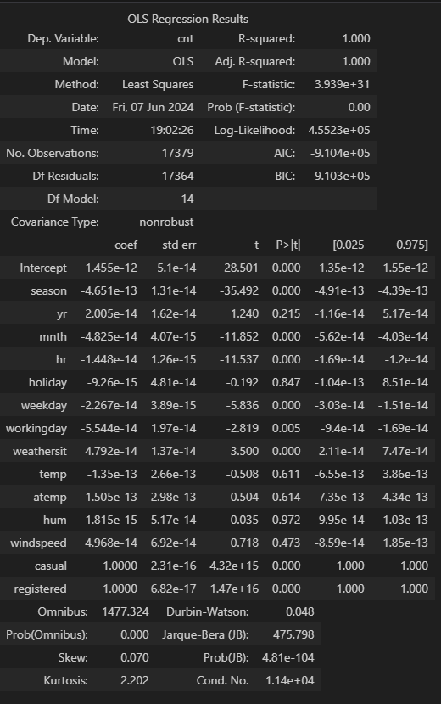
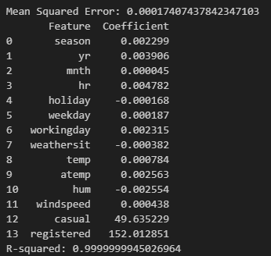
multiple linear regression
Ordinary Least Squares (OLS) regression analysis conducted on the dataset .
Dependent Variable:
- The dependent variable in the regression analysis is 'cnt,' representing the total count of bike rentals.
Model Information:
R-squared: The coefficient of determination, indicating the proportion of variance in the dependent variable that is explained by the independent variables. Here, R-squared is 1.000, indicating that the model explains 100% of the variance in bike rental counts.
Adj. R-squared: The adjusted R-squared, which adjusts for the number of predictors in the model. Also 1.000, indicating a perfect fit.
F-statistic and Prob: The F-statistic tests the overall significance of the regression model. With an extremely large F-statistic (3.939e+31) and a p-value of 0.00, the model is highly significant.
Coefficients
- The table provides the estimated coefficients (coef) for each predictor variable.
- std err: Standard error of the coefficient estimates.
- t-value: The t-statistic measures the significance of each coefficient. A larger absolute t-value indicates greater significance.
- P>|t|: The p-value associated with each coefficient. Smaller p-values indicate greater significance.
-[0.025, 0.975]: The 95% confidence interval for each coefficient.
Method: Least Squares method used for parameter estimation.
No. Observations: Number of observations in the dataset.
Covariance Type: Specifies the type of covariance estimation used in the model (nonrobust in this case).
Omnibus, Prob(Omnibus), Skew, Kurtosis: Measures of model fit and distributional assumptions.
Durbin-Watson: Test for autocorrelation in the residuals.
Jarque-Bera (JB), Prob(JB): Test for normality of residuals
Cond. No.: Condition number, a measure of multicollinearity.
Mean Squared Error (MSE):
The MSE quantifies the average squared difference between the actual values and the predicted values of the dependent variable (bike rental counts). A lower MSE indicates better model performance, as it reflects less error between the predicted and actual values
The model summary provides insights into the overall significance of the regression model, the individual significance of predictor variables, and the estimated effects of these variables on bike rental counts. These insights can guide further analysis, model refinement, and decision-making processes related to bike rental management

Slide 32
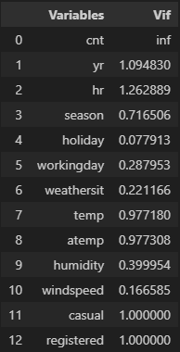
multiple linear regression
These results show the Variance Inflation Factor (VIF) for each predictor variable in the model. VIF measures the extent to which the variance of the coefficient estimates are inflated due to multicollinearity among the predictors:
Highly Inflated VIF:
  The VIF for the 'cnt' variable is shown as infinity (inf). This typically occurs when one of the predictors (in this case, 'cnt') is perfectly predicted by a linear combination of the other predictors. This suggests severe multicollinearity issues in the model, likely due to including the outcome variable ('cnt') as a predictor.
Low VIF:
  For most other predictor variables, the VIF values are relatively low, generally below 2. This indicates that there is little multicollinearity among these predictors, as VIF values below 5 are typically considered acceptable.
  'holiday' and 'windspeed' have particularly low VIF values, indicating very little multicollinearity with the other predictors in the model.
Interpretation:
  While most predictors have acceptable VIF values, the presence of severe multicollinearity with the outcome variable ('cnt') suggests potential issues with the model specification.
  It's essential to address the multicollinearity issue by reconsidering the inclusion of the 'cnt' variable as a predictor or exploring alternative modeling approaches.
  Additionally, further investigation may be needed to understand why 'cnt' is exhibiting perfect multicollinearity with the other predictors and how to appropriately model the relationship between predictors and the outcome variable.
while most predictors show acceptable levels of multicollinearity, the presence of severe multicollinearity with the outcome variable 'cnt' requires attention and potentially revisiting the model specification

Slide 33
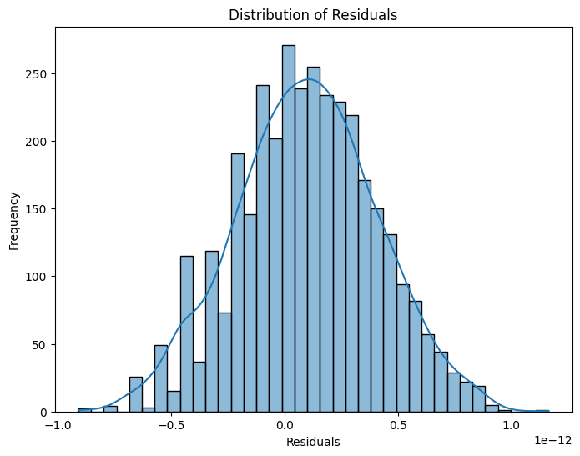
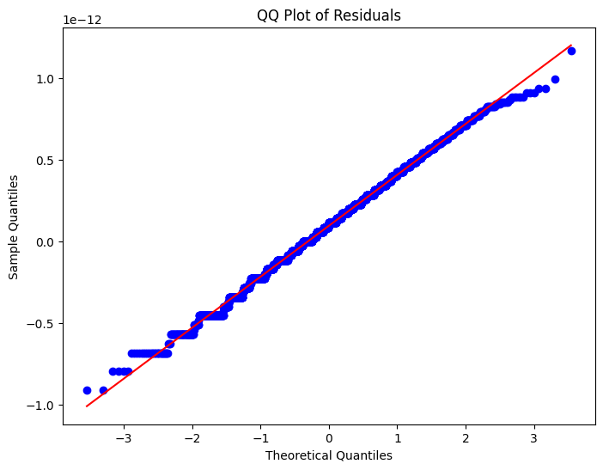
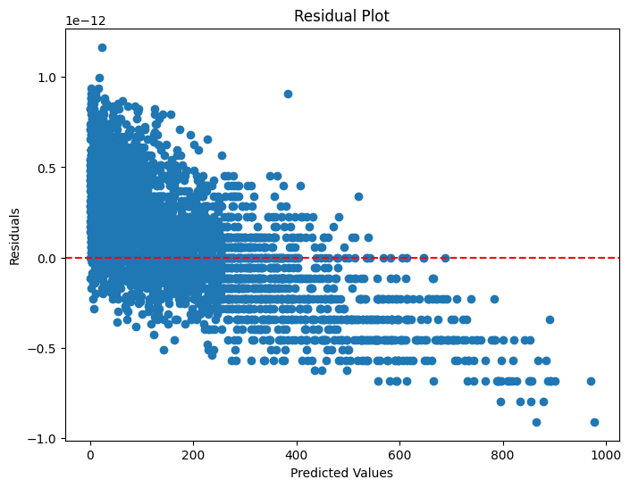
multiple linear regression
Linearity:
In the residual plot against the independent variables, non-random pattern from the horizontal line may suggest that the relationship between the independent variables and dependent variable ‘count’ is not linear.
Homoscedasticity:
The spread of residuals remains relatively constant as the independent variables change,
Hence homoscedasticity is satisfied.

Slide 34

Areas of focus

Slide 35




How we got there

Slide 36

Summary

Slide 37


Thank you

